Slide 1
Microprocessor BSc CSIT II SEM
Assembly Language Programming
Chapter Four
Bijay Babu Regmi
bijay.regmi@deerwalk.edu.np

Slide 2
Assembly Programming Language
Assembly language is a low-level programming language for a computer or other programmable device specific to a particular computer architecture in contrast to most high-level programming languages, which are generally portable across multiple systems.
Assembly language is converted into executable machine code by a utility program referred to as an assembler like NASM, MASM, etc.
Assembly programming language uses two, three or four letters mnemonics to represent each instruction type.
To make programming easier, many programmers write programs in assembly language.
They then translate Assembly language program to machine language so that it can be loaded into memory and run.
Assembly language programs consist of three types of statements:
- Executable instructions or instructions,
- Assembler directives or pseudo-ops, and
- Macros

Slide 3
Continued....
The executable instructions or simply instructions tell the processor what to do. Each instruction consists of an operation code (opcode). Each executable instruction generates one machine language instruction.
The assembler directives or pseudo-ops tell the assembler about the various aspects of the assembly process. These are non-executable and do not generate machine language instructions.
Macros are basically a text substitution mechanism.

Slide 4
Advantages
A program written in Assembly language requires considerably less memory and execution time then that of high level language.
Assembly language gives a programmer the ability to perform highly technical tasks.
Resident prgrams (that resides in memory while other programs execute) and Interrupt Service Routine that handles I/O and o/p) are almost always develop Assembly language.
It provides more control over handling particular hardware requirements.
It results in faster execution.

Slide 5
Syntax of Assembly Programming Language
Assembly language are written one statement in a line. The syntax of statement is as follow:
[Label] mnemonic operands [;comment]
Assembly language statements are usually written in a standard form that has four fields.
A label is a symbol used to represent an address which is optional. They are followed by colon.
The opcode field of the instruction contains the mnemonics for the instruction to be performed.
The operand field of the statement contains the data, the memory address, the port address or the name of the register on which the instruction is to be performed.
The final field is the comment field which starts with semicolon. It forms a well documented program.

Slide 6
Continued....
Examples:
INC COUNT ; Increment the memory variable COUNT
MOV TOTAL, 48 ; Transfer the value 48 in the
; memory variable TOTAL
ADD AH, BH ; Add the content of the
; BH register into the AH register
AND MASK1, 128 ; Perform AND operation on the
; variable MASK1 and 128
ADD MARKS, 10 ; Add 10 to the variable MARKS
MOV AL, 10 ; Transfer the value 10 to the AL register

Slide 7
Instruction Description and Classification
The computer can be used to perform a specific task, only by specifying the necessay steps to compute the tasks. The collection of such ordered steps from 'program' of a computer. These ordered steps are the computer instructions stored in central memory locations and are executed on a sequence at a time.
Each instruction of a program is pointed by the program counter (PC). It is first moved to instruction register (IR), then decoded into binary format and stored as an instruction in the memory. The computer takes a certain period to complete the task i.e. instruction fetching, decoding and execute on the basis of clock speed. Such a time period called 'Instruction Cycle' and consists two cycles namely fetch & decode and execute cycle.
Generally each instruction has two parts: one is the task to be operated on, called the operand or address field. The operand (or data) can be specified in various ways. It may include 8-bit (or 16-bit) data in an internal register, a memory location, or an 8-bit (or16-bit) address. The Op-code field specifies how data is to be manipulated and addrss field indicates the address of a data item. Though computer only understands binary language, it is complex and tedious for us to enter all the instructions in binary format.
Besides, identification and correction of errors in the program is even harder. So, the instructions are written in meaningful words (relating to task they perform) as mnemonics so that it is easier for programmers to learn, understand and use easily. For example

Slide 8
Continued....
ADD R1, R0
Opcode address:
Here, R0 is the source register and R1 is the destination register. The instruction adds the contents of R0 with the content of R1 and stores result in R1. There are three categories of instruction format depending on the number of address specified in instruction set:
One Byte Instruction:
- Here 1 byte will be op-code and operand will be default i.e. ADD B, MOV A,B
Two Byte Instruction:
- Here first byte will be op-code and second byte will be the operand/data i.e. IN 40H, MVI A 8-bit data
Three Byte Instruction:
- Here first byte will be op-code, second and third byte will be operands/data i.e. 2nd byte lower order data, 3r^{d} byte higher order data. For example: LXI B, 4050H

Slide 9
8085 Instruction Set
An instruction is a binary pattern designed inside a microprocessorr to perform a specific function.
The entire group of instructions that a microprocessor supports is called instruction set.
8085 has 246 instructions.
Each instruction is represented by an 8-bit binary value.
These 8-bits of binary value is called Op-code or Instruction Byte.
There are five different types of Instruction set:
- Data Transfer Instructions
- Arithmetic Instructions
- Logical Instructions
- Branching Instructions
- Control Instructions

Slide 10
Data Transfer Instructions
These instructions move data between registers, or between memory and registers.
These instructions copy data from source to destination (without changing the original data).
Some examples of data transfer instructions are:
Op-code | Operand | Meaning | Explanation
MOV | Rd, Source M, Source Dt, M | Copy from the source to the destination(Dt) | This instruction copies the contents of the source register into the destination register without any alteration. Example − MOV B, C
MVI | Rd, data M, data | Move immediate 8-bit | The 8-bit data is stored in the destination register or memory. Example − MVI B, 55H
LDA | 16-bit address | Load the accumulator | The contents of a memory location, specified by a 16-bit address in the operand, are copied to the accumulator. Example − LDA 2000H

Slide 11
Continued....
Op-code | Operand | Meaning | Explanation
LXI | Reg. pair, 16-bit address | Load the register pair immediate | The instruction loads 16-bit data in the register pair designated in the register or the memory. Example − LXI H, 2030H
LHLD | 16-bit address | Load H and L registers direct | The instruction copies the contents of the memory location pointed out by the address into register L and copies the contents of the next memory location into register H. Example − LHLD 2030H
SHLD | 16-bit address | Store H and L registers direct | The contents of register L are stored in the memory location specified by the 16-bit address in the operand and the contents of H register are stored into the next memory location by incrementing the operand. Example - SHLD 2000H

Slide 12
Continued....
Op-code | Operand | Meaning | Explanation
XCHG | None | Exchange H and L with D and E | The contents of register H are exchanged with the contents of register D, and the contents of register L are exchanged with the contents of register E. Example − XCHG
STA | 16-bit address | Store the contents of accumulator to 16-bit address | This is a 3-byte instruction, the second byte specifies the low-order address and the third byte specifies the high-order address. Example − STA 2000H
STAX | 16-bit address | Store the accumulator indirect | The contents of the accumulator are copied into the memory location specified by the contents of the operand. Example − STAX B
IN | 8-bit port address | Input data to accumulator from a port with 8-bit address | The contents of the input port designated in the operand are read and loaded into the accumulator. Example − IN 8CH

Slide 13
Arithmetic Instructions
These instructions perform the operations like addition, substraction, increment, decrement.
Op-code | Operand | Meaning | Explanation
ADD | R M | Add register or memory, to the accumulator | The contents of the register or memory are added to the contents of the accumulator and the result is stored in the accumulator. Example − ADD B
ADC | R M | Add register to the accumulator with carry | The contents of the register or memory & M the Carry flag are added to the contents of the accumulator and the result is stored in the accumulator. Example − ADC B
ADI | 8-bit data | Add the immediate to the accumulator | The 8-bit data is added to the contents of the accumulator and the result is stored in the accumulator. Example − ADI 55H

Slide 14
Continued....
Op-code | Operand | Meaning | Explanation
DAD | Reg. pair | Add the register pair to H and L registers | The 16-bit data of the specified register pair are added to the contents of the HL register. Example − DAD B
SUB | R M | Subtract the register or the memory from the accumulator | The contents of the register or the memory are subtracted from the contents of the accumulator, and the result is stored in the accumulator. Example − SUB B or M
SBB | R M | Subtract the source and borrow from the accumulator | The contents of the register or the memory & M the Borrow flag are subtracted from the contents of the accumulator and the result is placed in the accumulator. Example − SBB B or M
SBI | 8-bit data | Subtract the immediate from the accumulator with borrow | The contents of register H are exchanged with the contents of register D, and the contents of register L are exchanged with the contents of register E. Example − SBI 45H

Slide 15
Continued....
Op-code | Operand | Meaning | Explanation
INR | R M | Increment the register or the memory by 1 | The contents of the designated register or the memory are incremented by 1 and their result is stored at the same place. Example − INR B
INX | R | Increment register pair by 1 | The contents of the designated register pair are incremented by 1 and their result is stored at the same place. Example − INX D
DCR | R M | Decrement the register or the memory by 1 | The contents of the designated register or memory are decremented by 1 and their result is stored at the same place. Example − DCR C

Slide 16
Logical Instructions
These instructions perform logical operations on data stored in registers, memory and status flags.
The logical operations are AND, OR, XOR, rotate, compare, complement, etc.
Op-code | Operand | Meaning | Explanation
CMP | R M | Compare the register or memory with the accumulator | The contents of the operand (register or memory) are M compared with the contents of the accumulator
ANA | R M | Logical AND register or memory with the accumulator | The contents of the accumulator are logically AND with M the contents of the register or memory, and the result is placed in the accumulator. Example: ANA B or ANA M
XRA | R M | Exclusive OR register or memory with the accumulator | The contents of the accumulator are Exclusive OR with M the contents of the register or memory, and the result is placed in the accumulator. Example: XRA B or M

Slide 17
Continued....
Op-code | Operand | Meaning | Explanation
ORA | R M | Logical OR register or memory with the accumulator | The contents of the accumulator are logically OR with M the contents of the register or memory, and result is placed in the accumulator. Example: B or M
RLC | None | Rotate the accumulator left | Each binary bit of the accumulator is rotated left by one position. Bit D7 is placed in the position of D0 as well as in the Carry flag. CY is modified according to bit D7.
CMA | None | Complement accumulator | The contents of the accumulator are complemented. No flags are affected.
CMC | None | Complement carry | The Carry flag is complemented. No other flags are affected.
STC | None | Set carry | Set carry

Slide 18
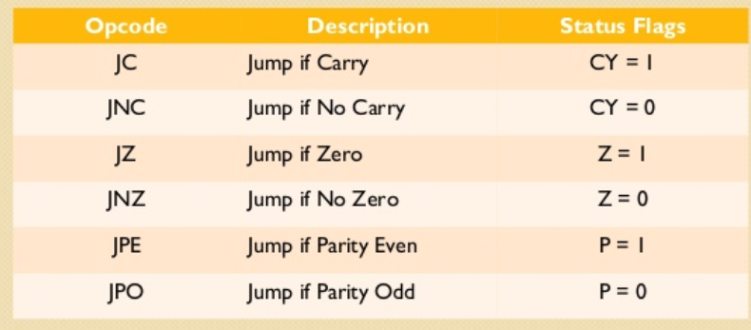
Branching Instructions
The branch group instructions allow the microprocessor to change the sequence of program either conditionally or under certain test conditions. The group includes jump instructions, call and return instructions and restart instructions.
Op-code | Operand | Meaning | Explanation
JMP | 16-bit address | Jump unconditionally | The program sequence is transferred to the memory address given in the operand. Example: JMP 2034H

Slide 19
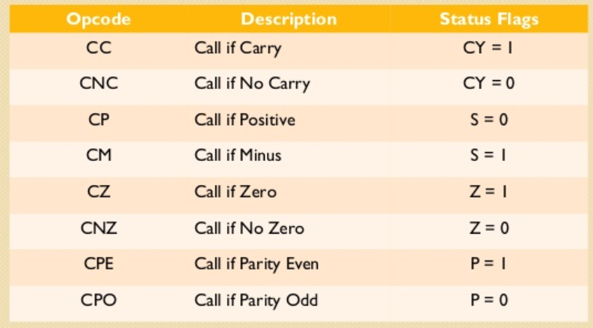
Continued....
Op-code | Operand | Meaning | Explanation
CALL | 16 bit address | Call unconditionally | The program sequence is transferred to the memory location specified by the 16-bit address given in the operand.

Slide 20
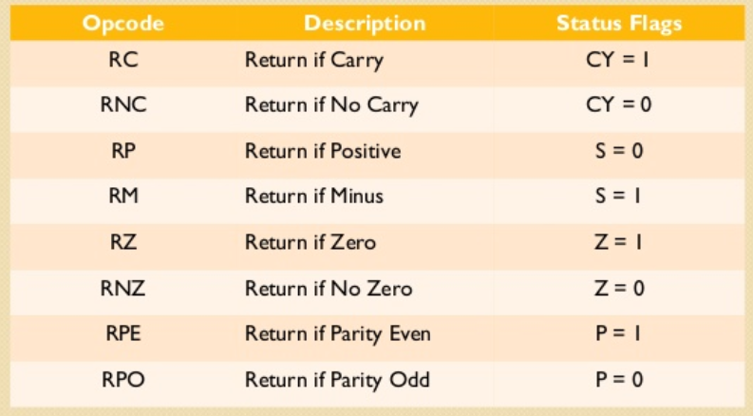
Continued....
Op-code | Operand | Meaning | Explanation
RET | None | Return unconditionally | The program sequence is transferred from the subroutine to the calling program.

Slide 21
Control Instructions
The control instructions control the operation of microprocessor.
Op-code | Operand | Meaning | Explanation
NOP | None | No operation | No operation is performed, i.e., the instruction is fetched and decoded.
HLT | None | Halt and enter wait state | The CPU finishes executing the current instruction and stops further execution. An interrupt or reset is necessary to exit from the halt state.
EI | Nne | Enable interrupts | The interrupt enable flip-flop is set and all the interrupts are enabled.
RIM | None | Read interrupt mask | This instruction is used to read the status of interrupts 7.5, 6.5, 5.5 and read serial data input bit.
SIM | None | Set interrupt mask | This instruction is used to implement the interrupts 7.5, 6.5, 5.5, and serial data output.

Slide 22
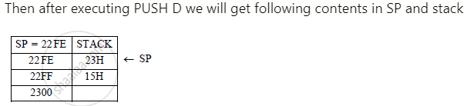
PUSH and POP Instruction
PUSH is a single byte instruction. The contents of the register pair specified in the operand are copied into the stack.
The stack pointer is decremented and the contents of higher order register in pair (such as B in BC pair, D in DE pair) are copied on stack.
The stack pointer is decremented again and contents of lower order register are copied on the stack. No flags are modified. Contents of register pair are unchanged.
Example: PUSH D
Let D = 15H and E = 23H
Let SP = 2300 H

Slide 23
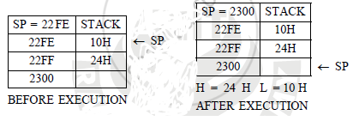
POP is single byte instruction. On execution, it copies two top bytes on stack to designated register pair in operand.
Contents of top must location of stack called stack top are copied into lower register (such as C in BC etc) of the pair. The SP is incremented by 1.
Contents of the stack location pointed by SP are copied into higher register of the pair. The stack pointer SP is incremented by 1. No flags are affected. Contents of stack are unchanged.
Example:
Consider SP = 22FE H with following contents stored on stack.
On execution of instruction POP H the contents of H, L, SP will be as shown in figure.

Slide 24
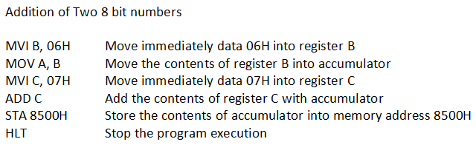
Addition of two 8 bit numbers

Slide 25
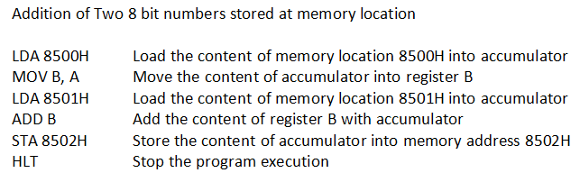
Continued....

Slide 26
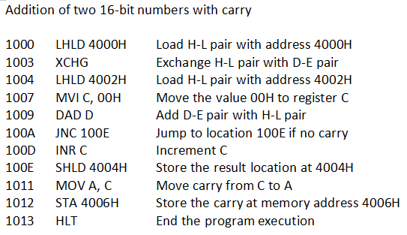
Continued....

Slide 27
Subtraction of two numbers
MVIC,00H Clear C register
LXIH,8000H Load initial address to get operand
MOVA, M Load Acc with the memory element
INX H Point to next location
MOVB, M Load B with the second operand
SUB B Subtract B from A
JNC STORE When CY = 0, go to STORE
INR C Increase C by 1
LXIH,8050H Load the destination address STORE
MOVM, A Store the result
INX H Point to next location
MOVM, C Store the borrow
HLT End the program

Slide 28
Assembly program to multiply two numbers
2000 LHLD 2050 Loads content of 2051 in H and content of 2050 in L
2003 XCHG Exchanges contents of H with D and contents of L with E
2004 MOV C, D Copies content of D in C
2005 MVI D 00 Assigns 00 to D
2007 LXI H 0000 Assigns 00 to H and 00 to L
200A DAD D Adds HL and DE and assigns the result to HL
200B DCR C Decrements C by 1
200C JNZ 200A Jumps program counter to 200A if zero flag = 0
200F SHLD 3050 Stores value of H at memory location 3051 and L at 3050
2012 HLT End the execution

Slide 29
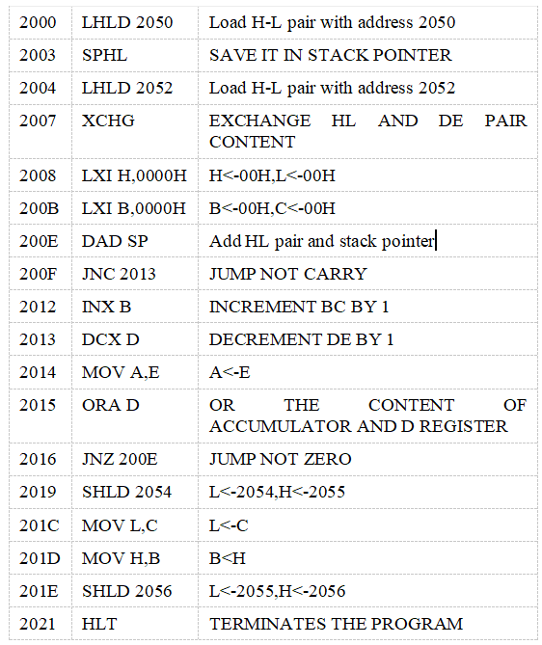
Assembly program to multiply two 16 bit numbers

Slide 30
Assembly program to divide two numbers
2000 MVI C, FFH Assign the value of C = FFH
2001 LXI H, 2050H Load the contents of 2050H
2004 MOV A, M Copy the value of memory to A
2005 INX H Increment the memory address
2006 MOV B, M Copy the value of memory to B
2007 INR C Increment the value of C
2008 SUB B Subtract: A - B
2009 JNC 2007 Jump to 2007 when no carry
200A ADD B Add: A + B
200B INX H Increment the memory address
200C MOV M, C Copy the content of C into memory address
200D INX H Increment the memory address
200E MOV M, A Copy the value of A into memory
200F HLT End the program

Slide 31
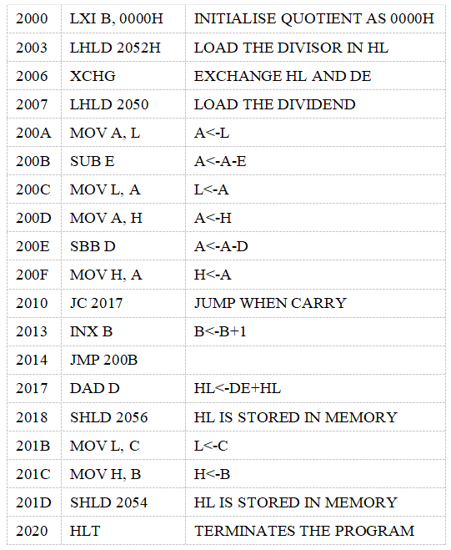
Assembly program to divide two 16 bit numbers

Slide 32
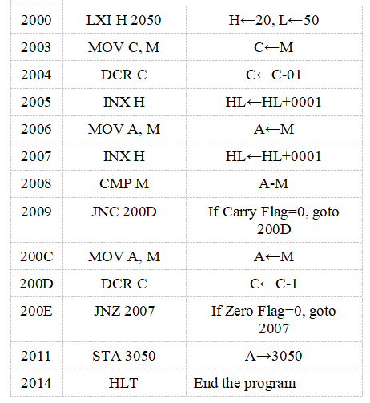
Assembly program to find largest number

Slide 33
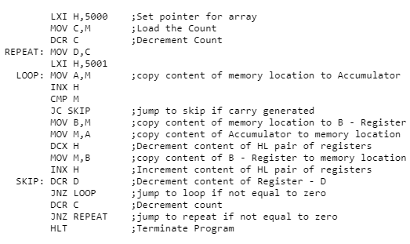
Assembly program to arrange an array of data in ascending order

Slide 34
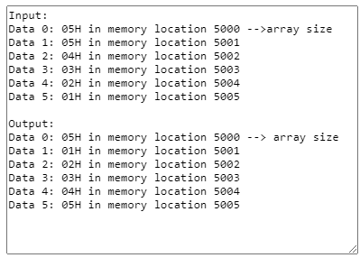
Output

Slide 35
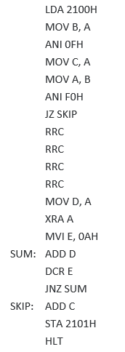

Assembly program to convert Decimal to Binary

Slide 36
Macro Assembler
Macro is a set of instructions grouped under a single unit. It is another method for implementing modular programming in the 8086 microprocessors (The first one was using Procedures).
The Macro is different from the Procedure in a way that unlike calling and returning the control as in procedures, the processor generates the code in the program every time whenever and wherever a call to the Macro is made.
A Macro can be defined in a program using the following assembler directives: MACRO (used after the name of Macro before starting the body of the Macro) and ENDM (at the end of the Macro). All the instructions that belong to the Macro lie within these two assembler directives. The following is the syntax for defining a Macro in the 8086 Microprocessor:

Slide 37
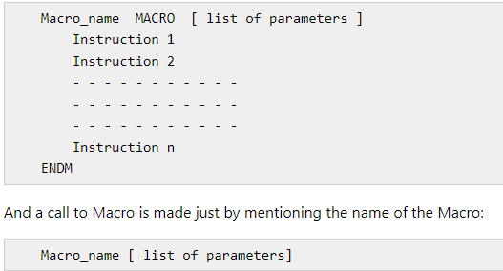

Slide 38
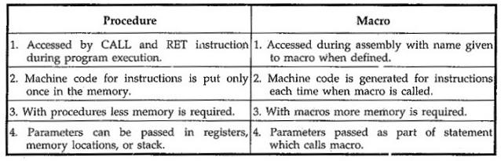
The difference between Macro and Procedure is:

Slide 39
Macro Assembler:
A macro assembler is able to generate a program segment, which is defined by a macro, when the name of the macro appears as an opcode in a program. The macro assembler is still capable of regular assembler functioning, generating a machine instruction for each line of assembly language code; but like a compiler, it can generate many machine instructions from one line of source code.
Its instruction set can be expanded to include new mnemonics, which generate these program segments of machine code. The following discussion of how a macro works will show how this can be done.

Slide 40
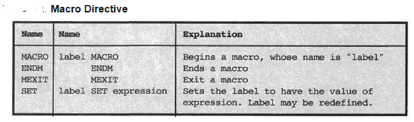

Slide 41
Assembling, Linking and Executing
Assembling converts source program into object program if syntactically correct and generates an intermediate .obj file or module.
It calculates the offset address for every data item in data segment and every instruction in code segment.
A header is created which contains the incomplete address in front of the generated obj module during the assembling.
Assembler complains about the syntax error if any and does not generate the object module.
Assembler creates .obj .lst and .crf files and last two are optional files that can be created at run time.
For short programs, assembling can be done manually where the programmer translates each mnemonic into the machine language using lookup table.
Assembler reads each assembly instruction of a program as ASCII character and translates them into respective machine code.

Slide 42
There are two types of assemblers:
One pass assembler: This assembler scans the assembly language program once and converts to object code at the same time.
This assembler has the program of defining forward references only. The jump instruction uses an address that appears later in the program during scan, for that case the programmer defines such addresses after the program is assembled.
b) Two pass assembler: This type of assembler scans the assembly language twice.
First pass generates symbol table of names and labels used in the program and calculates their relative address. This table can be seen at the end of the list file and here user need not define anything.
Second pass uses the table constructed in first pass and completes the object code creation. This assembler is more efficient and easier than earlier.

Slide 43
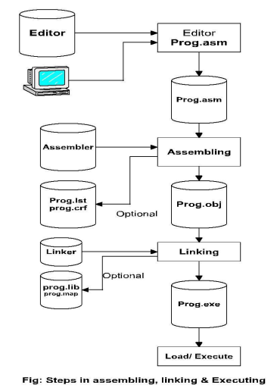

Slide 44
Linking: This involves the converting of .OBJ module into .EXE(executable) module i.e. executable machine code. It completes the address left by the assembler. It combines separately assembled object files. - Linking creates .EXE, .LIB, .MAP files among which last two are optional files.
Loading and Executing: It Loads the program in memory for execution. It resolves remaining address. This process creates the program segment prefix (PSP) before loading. It executes to generate the result.

Slide 45
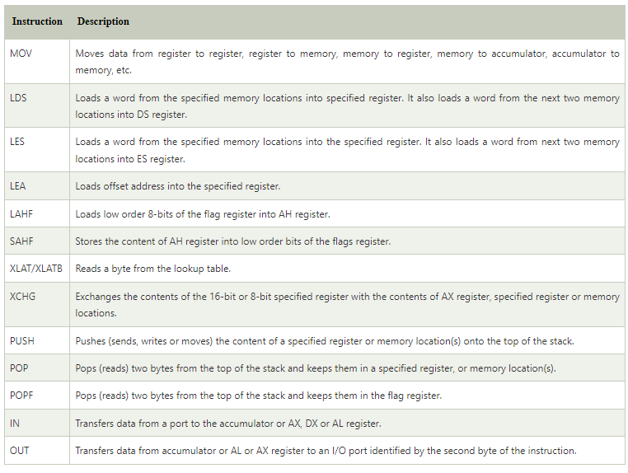
Instruction Set:
1. Data Transfer Instruction

Slide 46
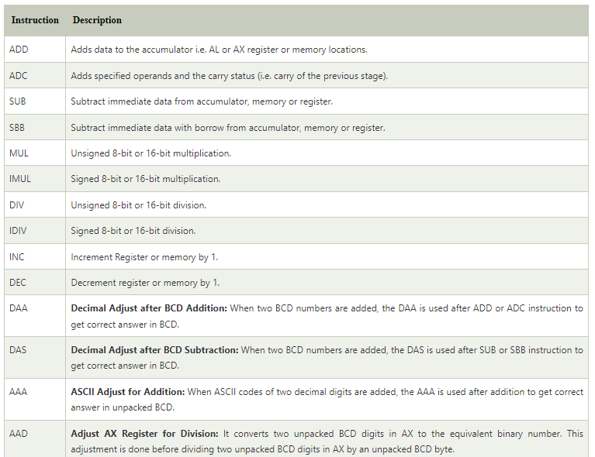
2. Arithmetic Instruction:

Slide 47
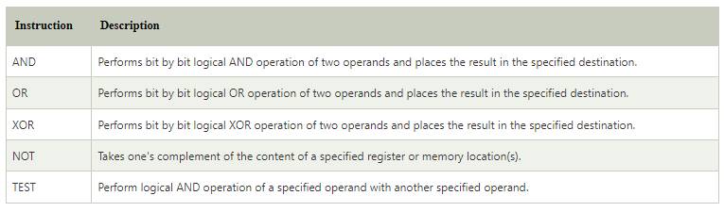
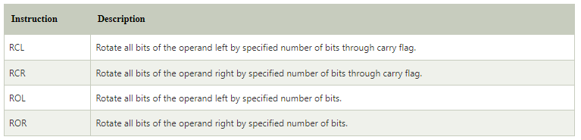
3. Logical Instructions:
4. Rotate Instructions:

Slide 48
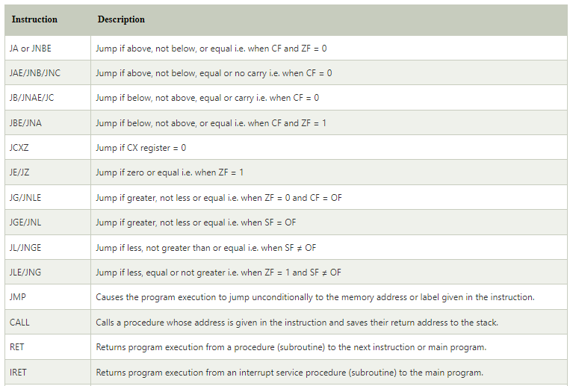
5. Branching Instructions:

Slide 49
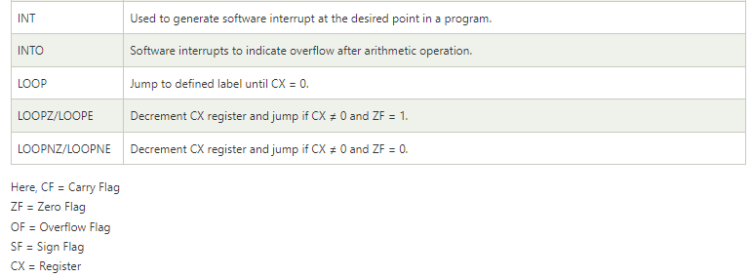
Continued….

Slide 50
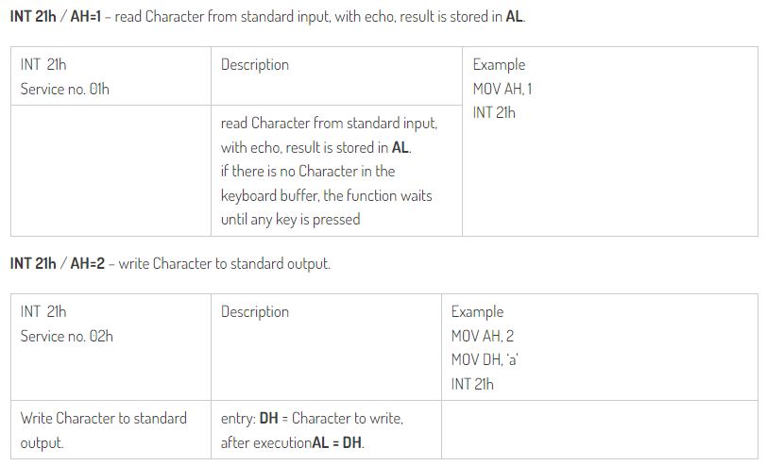
INT 21H Functions:
INT 21H is what makes a call into MS DOS. The 01H in the AH register indicates what DOS command to execute which, in this case, is to read a character from STDIN. The result will end up in the AL register. However, this call will only work if the code is executed from within the context of an MS DOS environment. If it is not, then it’s undefined what happens when INT 21H is called.

Slide 51
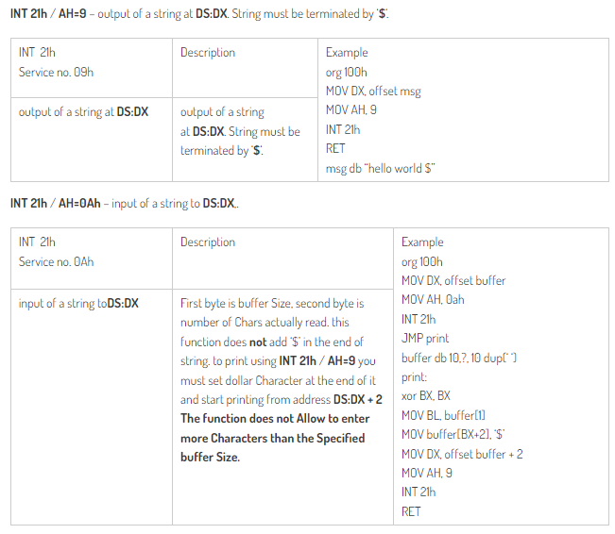

Slide 52
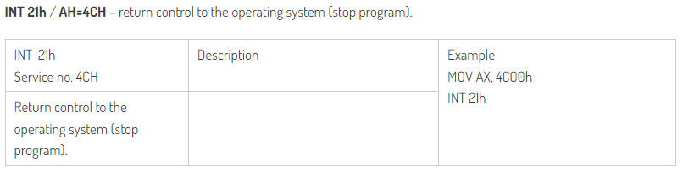

Slide 53
INT 10H
INT 10h, INT 10H or INT 16 is shorthand for BIOS interrupt call 10_{hex}, the 17th interrupt vector in an x86-based computer system. The BIOS typically sets up a real mode interrupt handler at this vector that provides video services. Such services include setting the video mode, character and string output, and graphics primitives (reading and writing pixels in graphics mode).
To use this call, load AH with the number of the desired sub function, load other required parameters in other registers, and make the call. INT 10h is fairly slow, so many programs bypass this BIOS routine and access the display hardware directly. Setting the video mode, which is done infrequently, can be accomplished by using the BIOS, while drawing graphics on the screen in a game needs to be done quickly, so direct access to video RAM is more appropriate than making a BIOS call for every pixel.

Slide 54
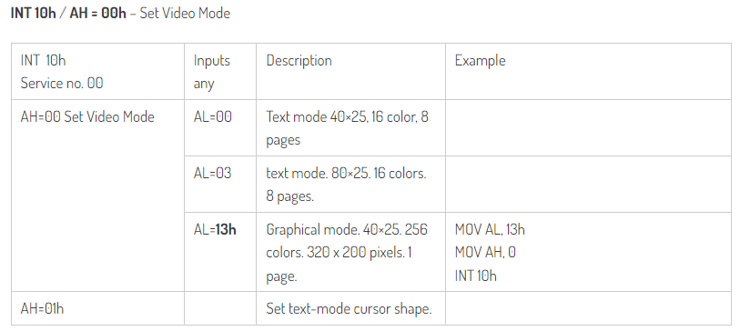

Slide 55
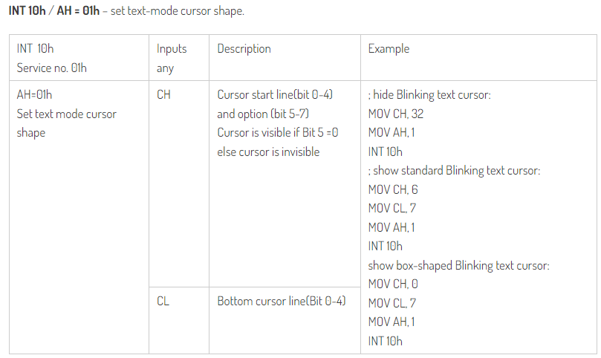

Slide 56
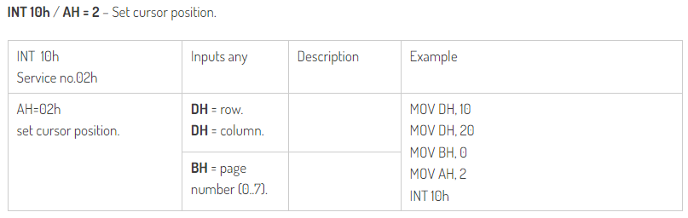
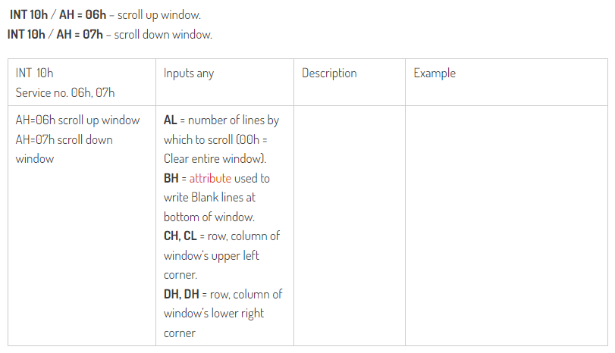

Slide 57
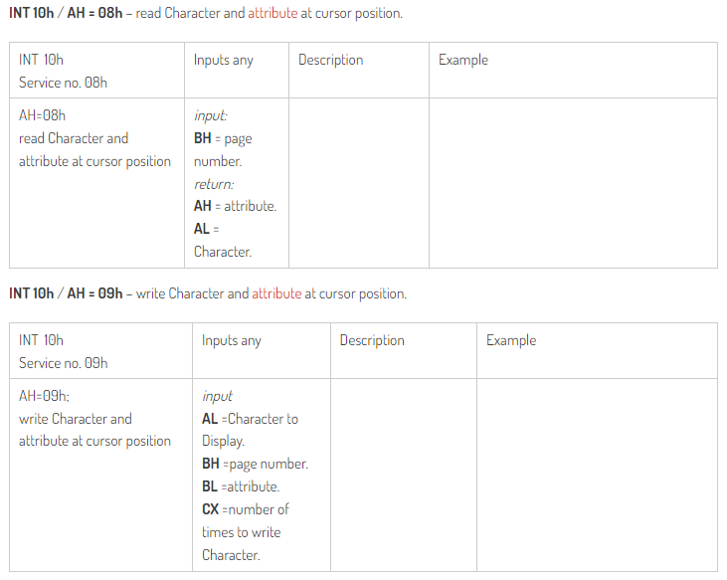

Slide 58
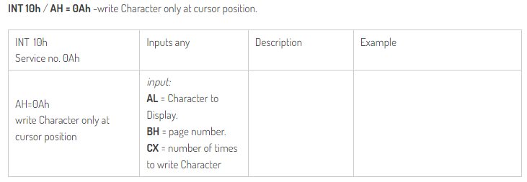

Slide 59
Addressing modes in 8086
Addressing modes describe types of operands and the way in which they are accessed for executing an instruction. An operand address provides source of data for an instruction to process an instruction to process. An instruction may have from zero to two operands. For two operands first is destination and second is source operand. The basic modes of addressing are register, immediate and memory which are described below.
Register Addressing: For this mode, a register may contain source operand, destination operand or both. E.g. MOV AH, BL MOV DX, CX
Immediate Addressing: In this type of addressing, immediate data is a part of instruction, and appears in the form of successive byte or bytes. This mode contains a constant value or an expression. E.g. MOV AH, 35H MOV BX, 7A25H
Direct memory addressing: In this type of addressing mode, a 16-bit memory address (offset) is directly specified in the instruction as a part of it. One of the operand is the direct memory and other operand is the register. E.g. ADD AX, [5000H] Note: Here data resides in a memory location in the data segment, whose effective address may be computed using 5000H as the Offset address and content of DS as segment address. The effective address, here, is 10H*DS + 5000H.

Slide 60
4) Indirect memory addressing:
Indirect addressing takes advantage of computer’s capability for segment: offset addressing. The registers used for this purpose are base register (BX and BP) and index register (DI and SI) E.g. MOV [BX], AL - ADD CX, [SI]
5) Base displacement addressing:
This addressing mode also uses base registers (BX and BP) and index register (SI and DI), but combined with a displacement (a number or offset value) to form an effective address. E.g. MOV BX, OFFSET ARR LEA BX, ARR MOV AL, [BX +2] ADD TBL [BX], CL TBL [BX] [BX + TBL] e.g. [BX + 4] 7)
6) Base index addressing:
This addressing mode combines a base registers (BX or BP) with an index register (SI or DI) to form an effective address. E.g. MOV AX, [BX +SI] ADD [BX+DI], CL

Slide 61
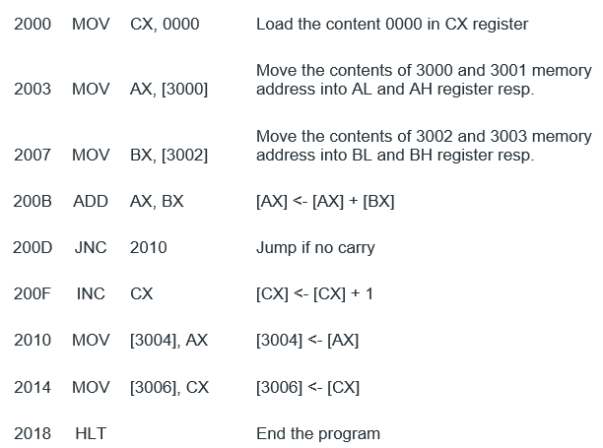
Assembly program to add two numbers (8086)

Slide 62
Assignment
Write an 8086 assembly program to subtract, multiply and divide any two numbers.

Slide 63
Assembly program to input and display a character
.MODEL SMALL .CODE START: MOV AH,1 ;asks for keyboard input. INT 21H ;stored in AL register. MOV DL,AL ;DL is the register used to display MOV AH,2 ;character output function INT 21H END START END

Slide 64
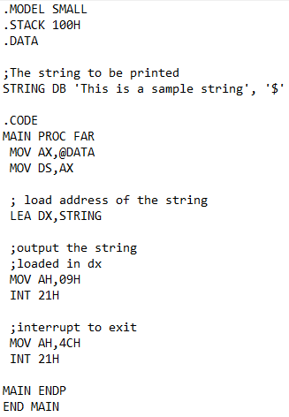
String Program

Slide 65
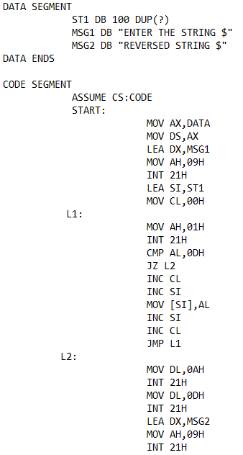
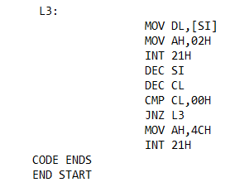
Assembly program to reverse a string

Slide 66
Debugging
Debugging is the process of identifying and removing bug from software or program. It refers to identification of errors in the program logic, machine codes, and execution. It gives step by step information about the execution of code to identify the fault in the program.
Debugging of machine code: Translating the assembly language to machine code is similar to building a circuit from a schematic diagram. Debugging can help in determining:
Values of register.
Flow of program.
Entry and exit point of a function.
Entry into if or else statement.
Looping of code.
Calculation check.

Slide 67
Common sources of error:
Selecting a wrong code
Forgetting second or third byte of instruction
Specifying wrong jump locations
Not reversing the order of high and low bytes in a Jump instruction
Writing memory addresses in decimal instead of hexadecimal
Failure to clear accumulator when adding two numbers
Failure to clear carry registers
Failure to set flag before Jump instruction
Specifying wrong memory address on Jump instruction
Use of improper combination of rotate instructions
The debugging process is divided into two parts:
Static Debugging: It is similar to visual inspection of circuit board, it is done by a paper and pencil to check the flowchart and machine codes. It is used to the understanding of code logic and structure of program.
Dynamic Debugging: It involves observing the contents of register or output after execution of each instruction (in single step technique) or a group of instructions (in breakpoint technique).

